Slide 1

CMP1101: DIODE ANALYSIS

Slide 2
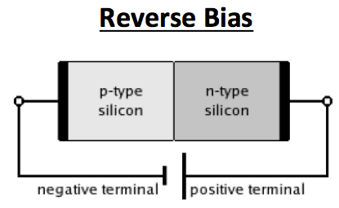
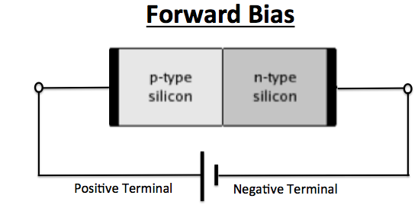
Review
Bias: the application of a voltage across a p-n junction.
Zero bias – no voltage applied, device attains a built in voltage at equilibrium.
Forward bias – direction of easy current flow.
Reverse bias – direction of little or no current flow.
With the battery connected this way,
The holes and electrons are respectively pulled away from the junction.
The depletion zone and the electric field grow.
Electrons and holes cannot cross the junction.
Electric current cannot flow through the semiconductor device.
Depletion region can break down if the electric field intensity exceeds a critical level.
Current then flows through the semiconductor.
With the battery connected this way,
The holes in the p-type push towards the junction.
Electrons in the n-type push towards the junction.
The depletion zone becomes neutralized.
The electric field resistance continues to fall.
Electrons and holes diffuse cross the junction in opposite directions.
Electric current flows through the semiconductor device.

Slide 3
Depletion Region Size and Voltage
For a p-n junction,
Let:
C_{A}(x) and C_{D}(x) be the concentrations of the acceptor and donor atoms respectively.
N_{o}(x) and P_{o}(x) be the equilibrium concentrations of the electrons and holes respectively.
d_{p} and d_{n} be the widths of the depletion region within the p-side and the n-side respectively.
D and ΔV be the represent the entire depletion region and the potential difference across it respectively.
Since the total charge on either side of the depletion region must cancel out.
It must be that:
d_{p}C_{A} = d_{n}C_{D}

Slide 4


Depletion Region Size and Voltage
Thus:
The equilibrium voltage is given by:
ΔV = ΔV_{o} + ΔV_{ext}
Where
ΔV_{o} and ΔV_{ext} are the equilibrium voltage and the bias voltage respectively.
q is the magnitude of the electron charge
ε is the permittivity
Since N_{o} = P_{o} = 0, because . . . . . . . . . .
Letting d be the total width of the depletion region,

Slide 5
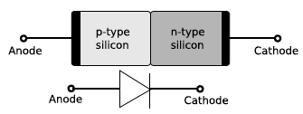
Diode
A discrete component that allows current to flow in one direction only.
General applications of diodes:
Rectifiers – circuits that convert alternating current or alternative voltage into direct current or voltage.
Detectors – circuits that find signals in noisy operation conditions.
Switching circuits – since an ideal diode acts like a perfect conductor when forward biased and acts like a perfect insulator when reverse biased.
The p-n junction effectively a diode.
The anode has positive potential and therefore collects electrons in the device. The reverse is true for the cathode.

Slide 6
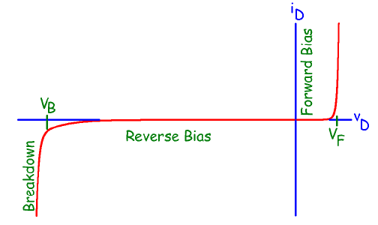
Diode
A diode is a nonlinear device and therefore it’s output current is not proportional to the input voltage.
A plot of the diode current against the input voltage (i-v characteristic or output characteristic) produces a nonlinear trace.
Typical i-v characteristic of a diode is as represented below.
V_{F}: Forward Voltage, typically 0.3V - 0.7V
V_{B}: Breakdown Voltage
(Typically between 3.3V - kV)
A small current is witnessed for the first small fraction of voltage application.
After approaching some voltage begin to cross the junction in large numbers.
Knee voltage
Above this voltage, the slightest increase in voltage results in a large current growth.
Only the bulk resistance (of less than 1Ω ) impedes the flow of current. Typical i-v characteristic of a diode is as represented above.

Slide 7

Graphical Analysis of Diode Circuits
Derived through the use of Thevenin’s equivalent circuits.
Built on determining the short circuit current I_{sc} and open circuit voltage V_{oc} operational on a circuit with a Thevenin equivalent resistance R_{TH}.
Thus:
The circuit current and voltage are plotted along side the diode i-v characteristic.
The process is referred to as load line analysis.
Graphical solutions provide insight but are neither convenient nor accurate.

Slide 8
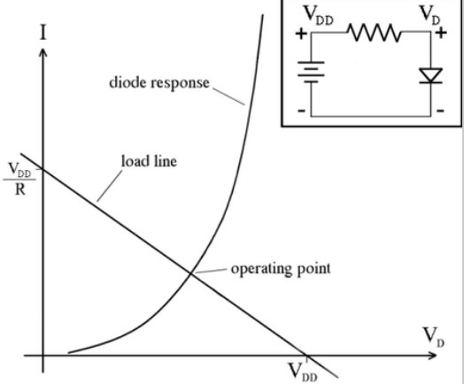
Graphical Analysis of Diode Circuits

Slide 9
Analysis Through Diode Models
Diode models provide more accuracy and/or convenience than the graphical analysis method.
Examples include:
Shockley equation:
Provides accuracy but is not so convenient.
The diode i-v characteristic is often approximated to provide convenience.
Ideal diode model:
The diode breakdown regions are ignored.
Both diode operation regions are thus analyzed as being linear.
Linear diode model:
Generalizes the ideal diode concept and uses linear approximations for all nonlinear portions of the diode i-v characteristic.

Slide 10
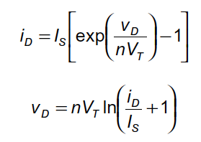
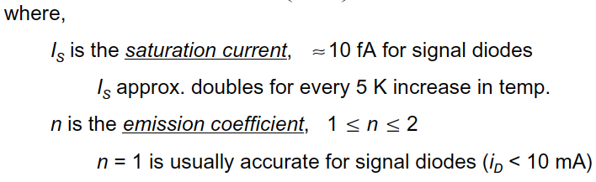
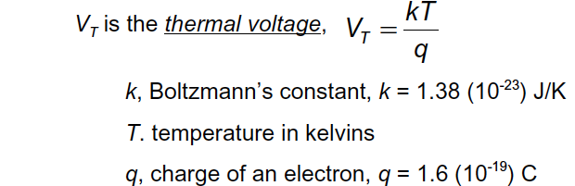

Shockley Ideal Diode Equation
Formulates the i-v characteristic of an idealized diode in either the forward or reverse bias.
Provide accuracy in the analysis of diode circuits.
OR
Sometimes referred to as the ideality factor or the quality factor

Slide 11



Shockley Equation Approximations
Forward bias:
Reverse bias:
High current:

